Slide 1


Amy Evangelista
Monday, January 24th, 2023

Slide 2

Outline
Executive Summary
Introduction
Methodology
Results
Conclusion
Appendix

Slide 3
Executive Summary
Summary of methodologies
Data Collection
Data Wrangling
Exploratory Data Analysis with Data Visualization
Exploratory Data Analysis with SQL
Building an interactive map with Folium
Building an interactive dashboard with Plotly Dash
Predictive analysis – classification
Summary of all results
Exploratory Data Analysis Results
Interactive Analysis Results
Predictive Analysis Results

Slide 4
Introduction
BACKGROUND
SpaceX advertises Falcon 9 rocket launches on its website with a cost of 62 million dollars; other providers cost upward of 165 million dollars each, much of the savings is because SpaceX can reuse the first stage. Therefore if we can determine if the first stage will land, we can determine the cost of a launch. This information can be used if an alternate company wants to bid against SpaceX for a rocket launch.
Problems you want to find answers
We would like predict if the Falcon 9 first stage will land successfully.
Which factors affect the Falcon 9 landing successfully?

Slide 5

Section 1

Slide 6
Methodology
Executive Summary
Data collection methodology:
Request rocket launch data from the SpaceX Rest API
Perform Webscraping on the Space X Wikipedia
Perform Data Wrangling
One hot encoding data fields for machine learning
Data cleaning by eliminating unnecessary columns and replacing null values
Perform Exploratory Data Analysis using Data Visualization and SQL
Perform interactive visual analytics using Folium and Plotly Dash
Perform predictive analysis using classification models
Employed Logistic Regression, K-Nearest Neighbor (KNN), Support Vector Machines,(SVM) and Decision Trees to predict rocket launch outcome

Slide 7
Data Collection
Combine available SpaceX data using the Space X Rest API and information from SpaceX Wikipedia page. The HTML gathered from webscraping is parsed using the Beautiful Soup library.
SpaceX Rest API
Use API to get JSON of Space X Data
Webscraping Space X Wikipedia Page
Get HTML using Requests library
Extract Data using Beautiful Soup
Data ready for consolidation and data wrangling
Normalize data in .csv file

Slide 8
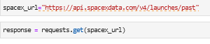
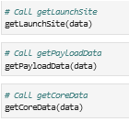
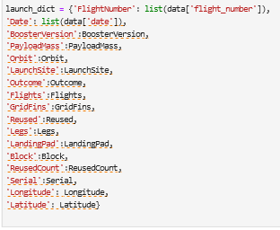
Data Collection – SpaceX API
Get Response from SpaceX API
Convert Response to .json file
Apply custom functions to clean data
Assign lists to dictionary and then pandas dataframe
Filter dataframe and export to .csv file
https://github.com/AmyLEvangelista/Data-Collection-API/blob/main/jupyter-labs-spacex-data-collection-api(1).ipynb

Slide 9
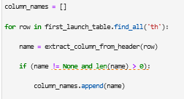
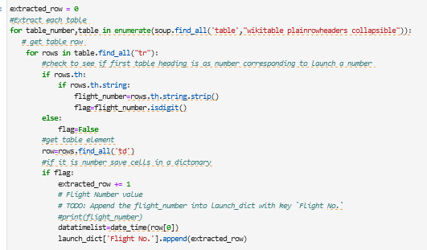
https://github.com/AmyLEvangelista/Data-Collection-API/blob/main/jupyter-labs-webscraping(1).ipynb
Data Collection - Scraping
1. Get HTML response from request
2. Create Beautiful Soup Object
3. Find tables
4. Get column names
5. Create dictionary
6. Append data values to keys
7. Convert Diction to dataframe
8. Convert dataframe to .csv

Slide 10
Data Wrangling
Check for nulll values
Calculate the number of launches on each site
Calculate the number and occurrence of each orbit type
Handle null values
Calculate the number and occurence of mission outcome per orbit type
Create a landing outcome label from Outcome column
https://github.com/AmyLEvangelista/Data-Collection-API/blob/main/IBM-DS0321EN-SkillsNetwork_labs_module_1_L3_labs-jupyter-spacex-data_wrangling_jupyterlite.jupyterlite.ipynb

Slide 11
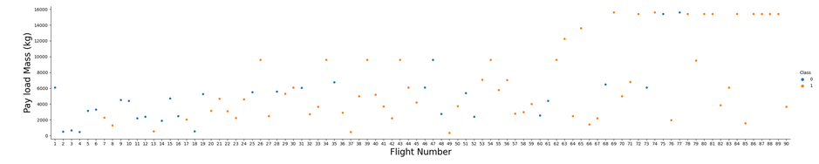
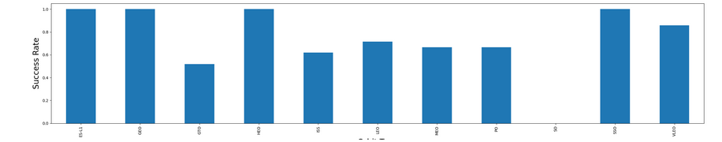
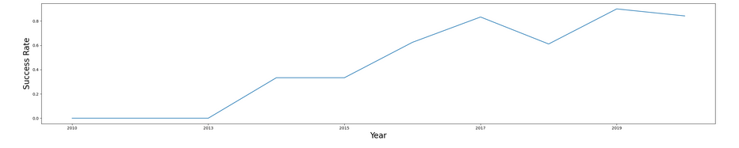
EDA with Data Visualization
Success rate by Orbit shows most successful orbits
Payload vs. Flight No. Shows heavier rockets have a better success
Success rate by year shows an increasing success rate after 2013
https://github.com/AmyLEvangelista/Data-Collection-API/blob/main/IBM-DS0321EN-SkillsNetwork_labs_module_2_jupyter-labs-eda-dataviz.ipynb.jupyterlite.ipynb

Slide 12
EDA with SQL
SQL queries performed
Displaying the names of the unique launch sites
Displaying launch sites like 'KSC'
Displaying the total payload mass from NASA(CRS)
Displaying the average payload mass of booster version F9 v1.1
Listing the dates where successful landing was achieved
List the names of the boosters which have success in drone ship and have payload mass greater than 4000 but less than 6000
List the total number of successful and failure mission outcomes
List the names of the booster_versions which have carried the maximum payload mass
List the failed landing_outcomes in drone ship, their booster versions, and launch site names for in year 2015
Rank the count of landing outcomes (such as Failure (drone ship) or Success (ground pad)) between the date 2010-06-04 and 2017-03-20, in descending order
https://github.com/AmyLEvangelista/Data-Collection-API/blob/main/Exploratory%20Data%20Analysis%20with%20SQL.ipynb

Slide 13
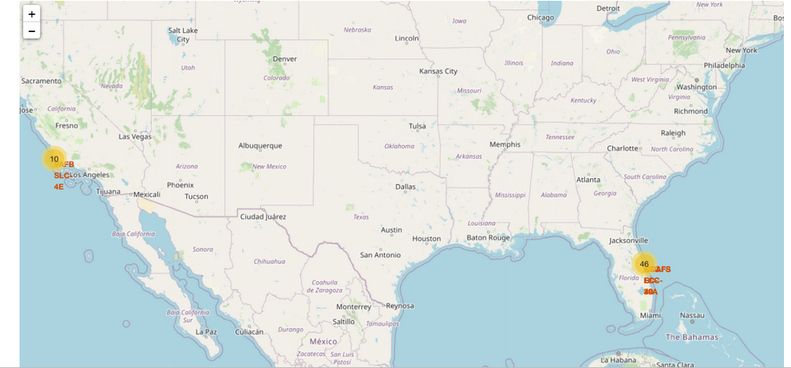
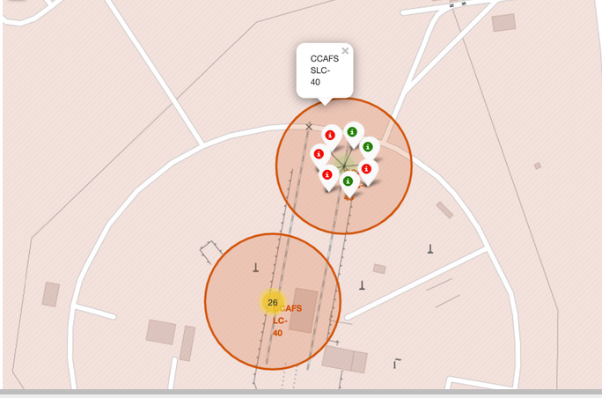
Build an Interactive Map with Folium
Added location of launch sites to map, and the color coded them for success rates and measured distances to highways, railways, coastlines, etc.
https://github.com/AmyLEvangelista/Data-Collection-API/blob/main/Launch%20Site%20location%20Analysis%20with%20Folium.ipynb

Slide 14
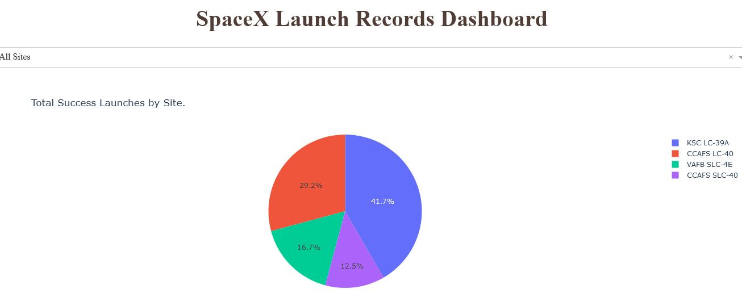
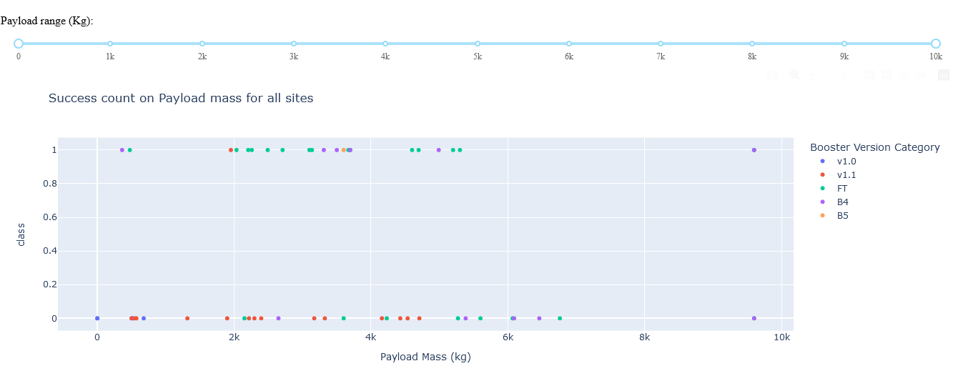
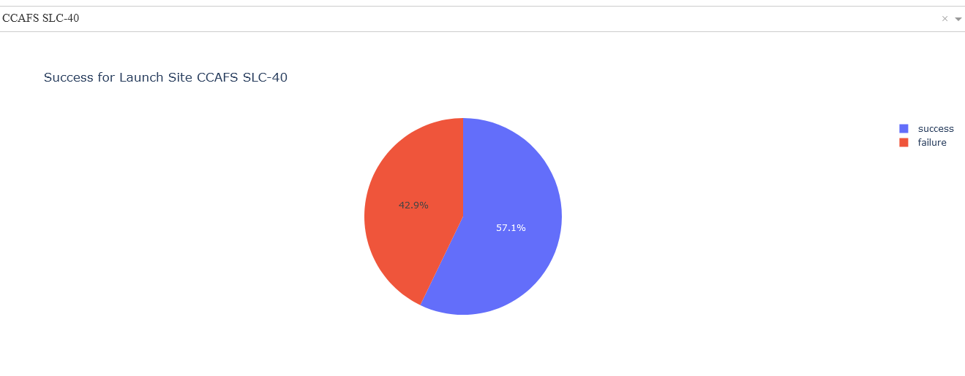
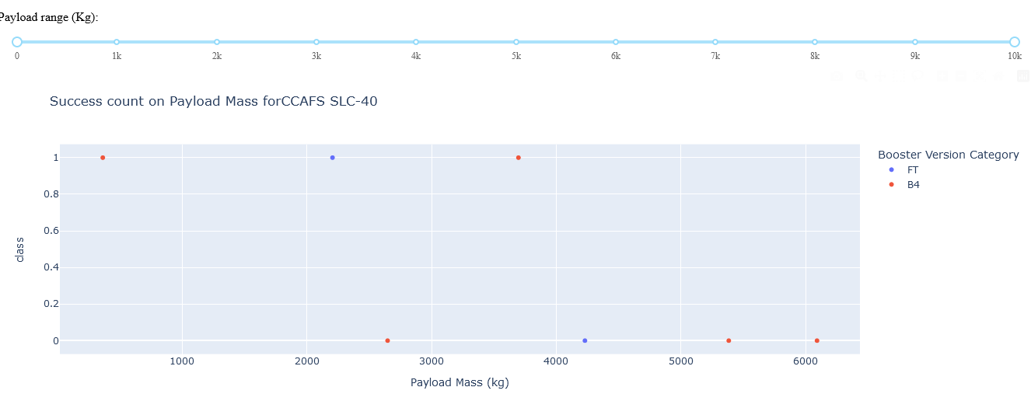
Build a Dashboard with Plotly Dash
The dashboard organizes data for 'All Sites' and specific sites, outline success rate, booster version and payload
https://github.com/AmyLEvangelista/Data-Collection-API/blob/main/spacex_dash_app1.py

Slide 15
Predictive Analysis (Classification)
Load the dataframe
Create a logistic regression object then create a GridSearchCV object
Display the best parameters using the data attribute best_params_ and the accuracy on the validation data using the data attribute best_score_
Calculate the accuracy on the test data using the method score
Create a NumPy array from the column Class in data, by applying the method to_numpy()
Standardize the data using.fit_transform()
Use the function train_test_split to split the data X and Y into training and test data.
Repeat the process as Support Vector Machine(SVM), K- Nearest Neighbor (KNN) and Desion Tree (tree_cv)
https://github.com/AmyLEvangelista/Data-Collection-API/blob/main/IBM-DS0321EN-SkillsNetwork_labs_module_4_SpaceX_Machine_Learning_Prediction_Part_5.jupyterlite(1).ipynb

Slide 16
Results
Exploratory data analysis results
Rockets with heavier payloads were more successful
After 2013 rocket success began to increase
Orbits GEO, SSO, HEO & ES L1 had the greatest success rate
Predictive analysis results
Support Vector Machine had the highest accuracy of predicting the landing of the rocket
Logistic Regression was best at predicting the outcome of rockets that did not land

Slide 17

Section 2

Slide 18
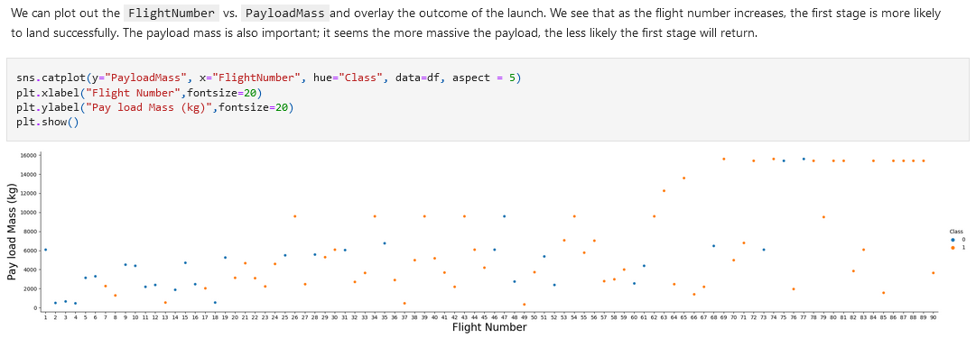
Flight Number vs. Launch Site

Slide 19
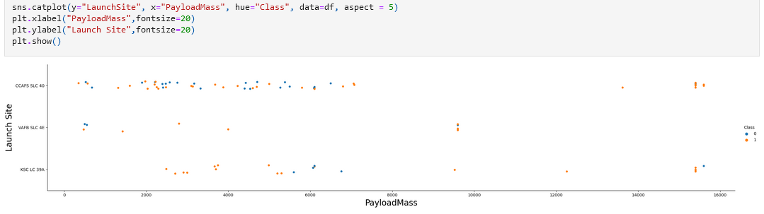
Payload vs. Launch Site

Slide 20
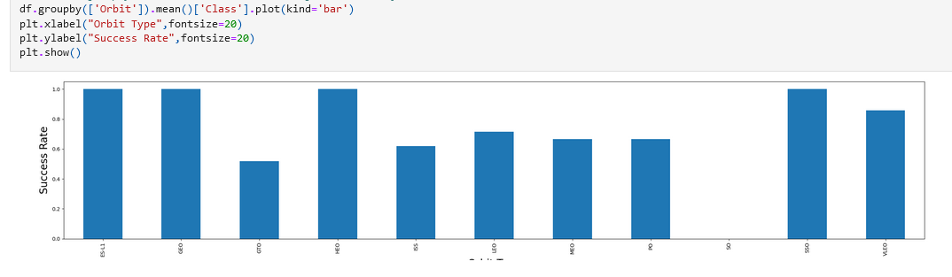
Success Rate vs. Orbit Type

Slide 21
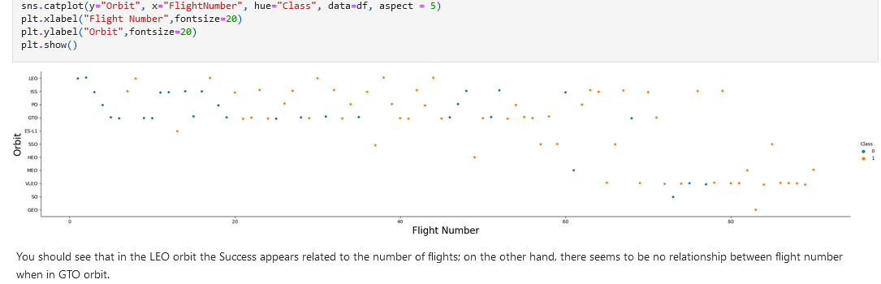
Flight Number vs. Orbit Type

Slide 22
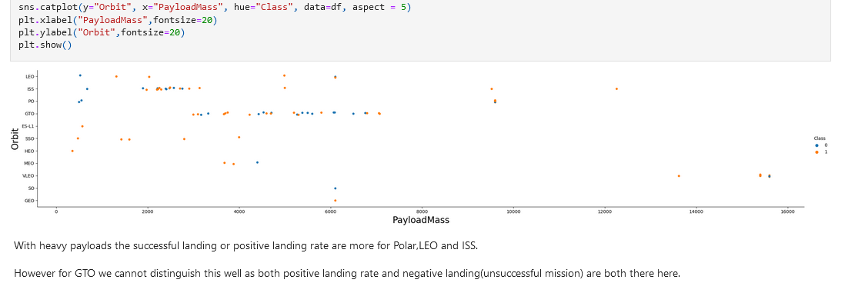
Payload vs. Orbit Type

Slide 23
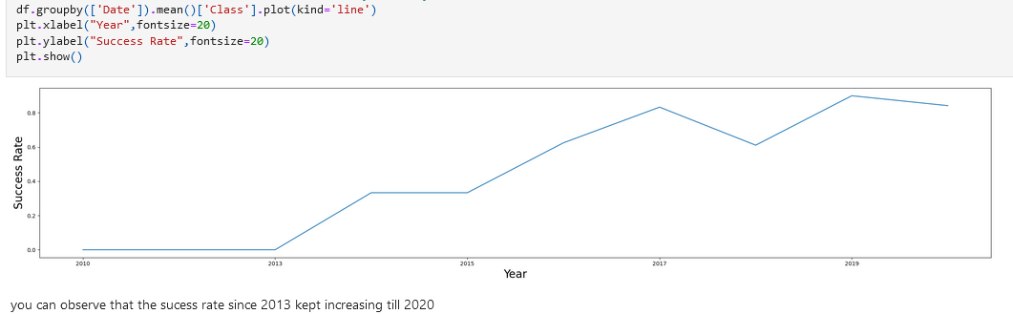
Launch Success Yearly Trend

Slide 24
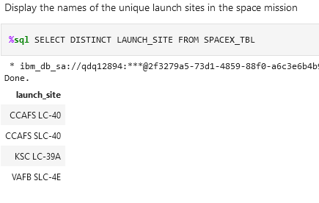
All Launch Site Names

Slide 25
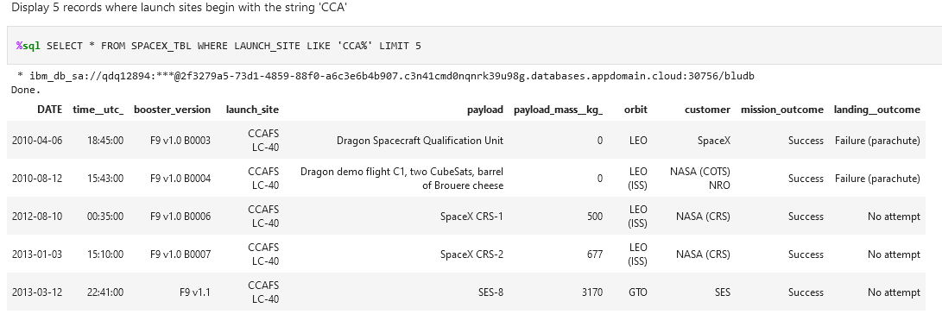
Launch Site Names Begin with 'CCA'

Slide 26
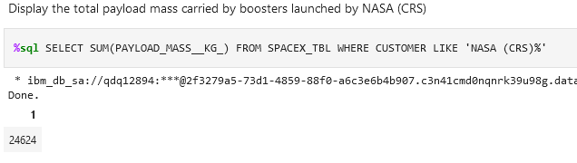
Total Payload Mass

Slide 27
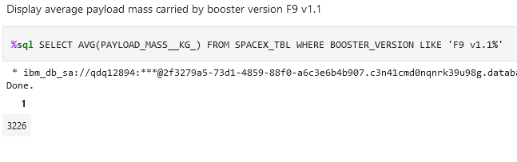
Average Payload Mass by F9 v1.1

Slide 28
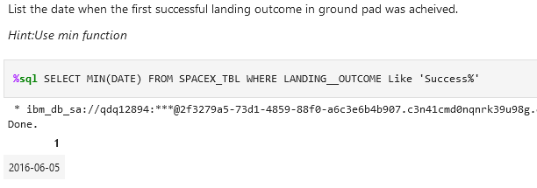
First Successful Ground Landing Date

Slide 29
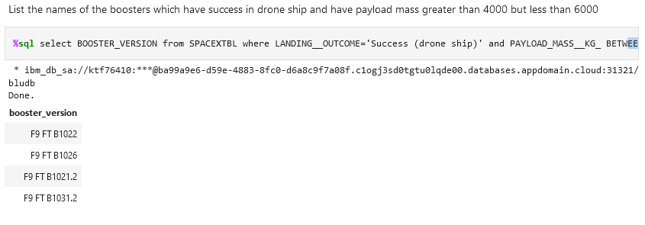
Successful Drone Ship Landing with Payload between 4000 and 6000

Slide 30
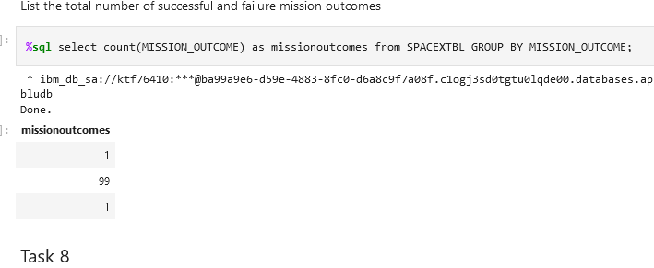
Total Number of Successful and Failure Mission Outcomes

Slide 31
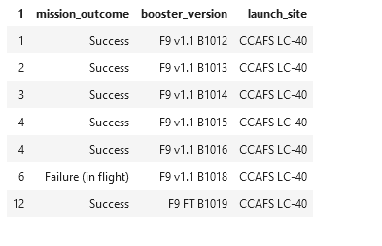
Boosters Carried Maximum Payload
%sql SELECT MONTH(DATE),MISSION_OUTCOME,BOOSTER_VERSION,LAUNCH_SITE FROM SPACEXTBL where EXTRACT(YEAR FROM DATE)='2015';

Slide 32
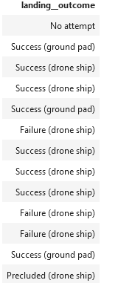
2015 Launch Records
%sql SELECT LANDING__OUTCOME FROM SPACEXTBL WHERE DATE BETWEEN '2010-06-04' AND '2017-03-20' ORDER BY DATE DESC;

Slide 33
Rank Landing Outcomes Between 2010-06-04 and 2017-03-20
Rank the count of landing outcomes (such as Failure (drone ship) or Success (ground pad)) between the date 2010-06-04 and 2017-03-20, in descending order
Present your query result with a short explanation here

Slide 34

Section 3

Slide 35
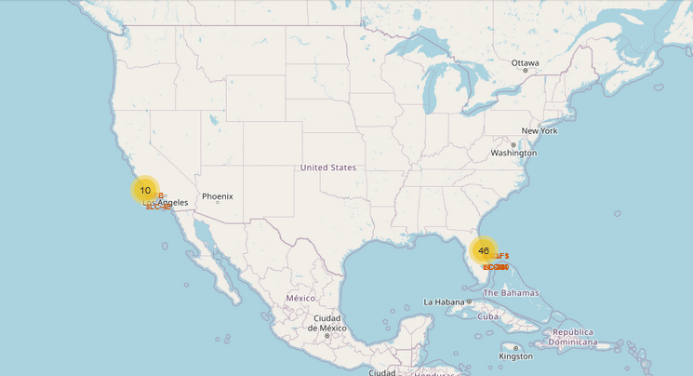
Folium Map of SpaceX Launch locations
The locastions of Space X launch sites are on both the east and west coast of the United States.

Slide 36
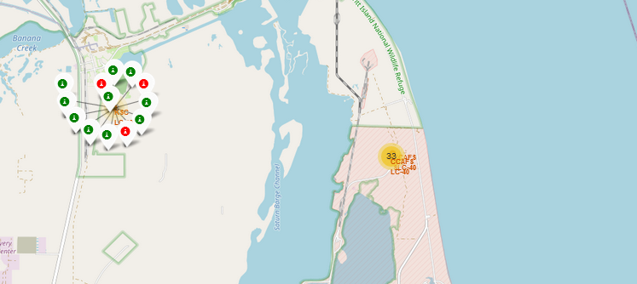
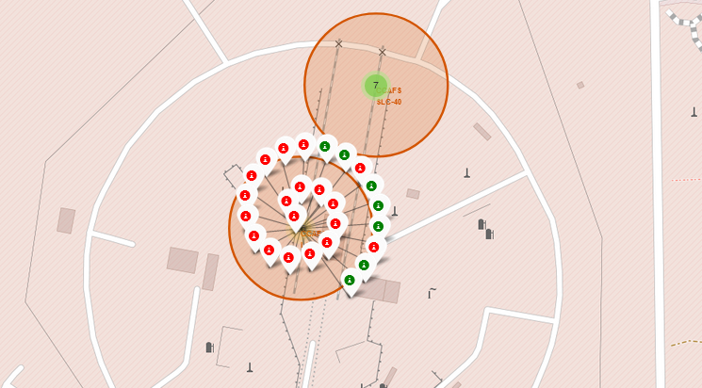
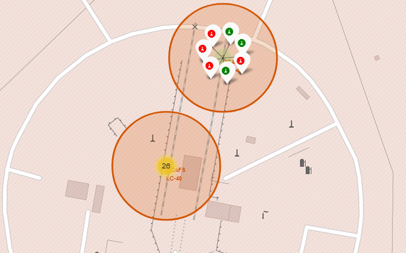
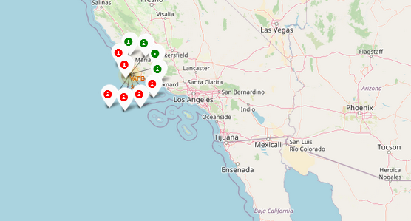
Folium Map of launch successes
The launch site KSC LC 39A has the highest success rate of all of the sites.

Slide 37
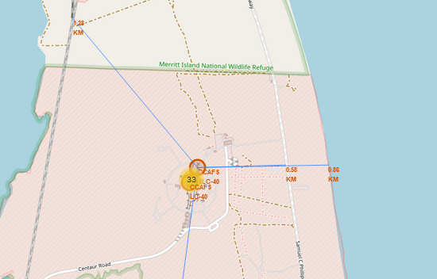
Folium Map distance to Proximaties
closest highway = 0.58 km closest railroad = 1.28 km closest city = 51.434 km
distance to coastline = .86km

Slide 38

Section 4

Slide 39
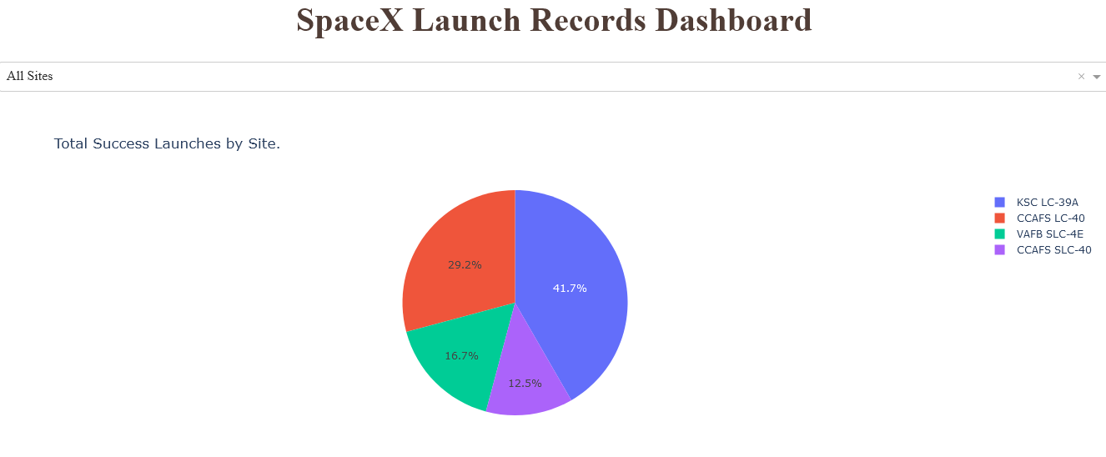
Plotly Dashboard of Launch Success by Site
Launch Site KSC LC39A has the most launch successes of any site.

Slide 40
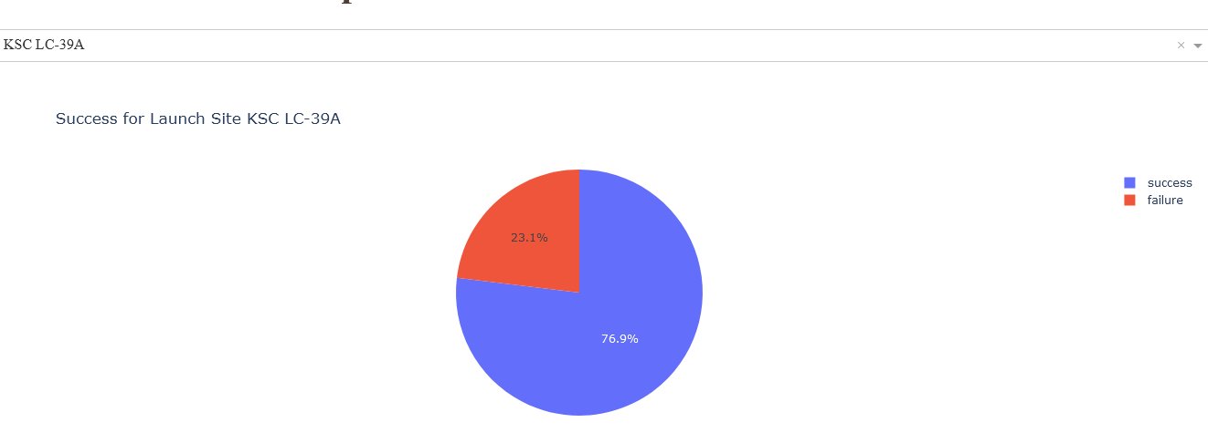
Launch Success Rate for site KSC LC-39A
The launch success rate for site KSC LC-39A is 76.9%

Slide 41
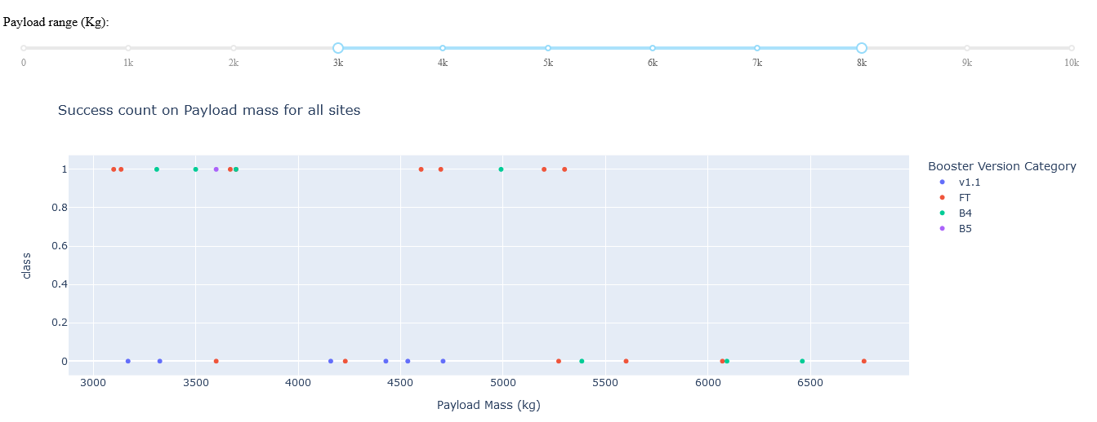
Payload vs. Launch Outcome Scatter Plot for all sites with Payload Range Slider
Booster version FT has the most successful launches with payload between 3k-8k
Booster version B4 has the highest success rate & the heaviest payloads.

Slide 42

Section 5

Slide 43
Classification Accuracy

Slide 44
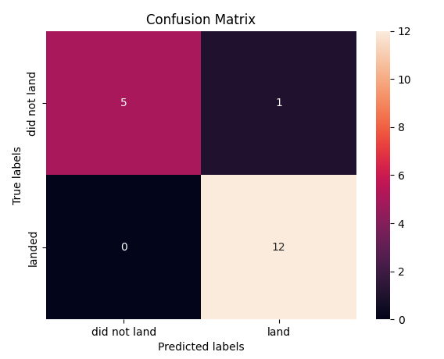
Confusion Matrix
The Confusion Matrix of the Support Vector Machine Shows that there is a high accuracy predicting launches that will land and are slightly weaker in predicting which launches will not land.

Slide 45
Conclusions
Exploratory data analysis results
Rockets with heavier payloads were more successful
After 2013 rocket success began to increase
Orbits GEO, SSO, HEO & ES L1 had the greatest success rate
Predictive analysis results
Support Vector Machine had the highest accuracy of predicting the landing of the rocket
Logistic Regression was best at predicting the outcome of rockets that did not land

Slide 46
Appendix
https://github.com/AmyLEvangelista/Data-Collection-API

Slide 47


